Slide 1
CAN THO UNIVERSITY COLLEGE OF INFORMATION AND COMMUNICATION TECHNOLOGY
PRODUCT RECOMMENDATION SYSTEM USING WORD2VEC
Student: Tran Dang Khoa
Student ID: B2014926
Class: 2020-2025 - DI20V7F2 - K46
Advisor: Associate Professor, PhD Nguyen Thai Nghe
Notes:
Gd moring teacher,
My name is Tran Dang Khoa ID student: B2014926
My research topic is recommendation system using word2vec model
My instructor is teacher Nguyen Thai Nghe

Slide 2
CONTENT REPORT
INTRODUCTION
RELATIVE STUDY
METHODOLOGY
CONCLUSION
Notes:
The report content includes 5 parts:
Introduction
Relative study
Methodology
Conclusion
Now, will enter the first content which is

Slide 3
1. INTRODUCTION
Word2Vec, a powerful word embedding model, represents words as dense vectors in a continuous vector space, capturing semantic relationships between words.
The findings of this study are expected to offer valuable insights into the integration of natural language processing (NLP) techniques with recommendation systems, paving the way for more effective and intelligent solutions in e-commerce
Notes:
NEXT, Next, we will come to the first part

Slide 4
1. INTRODUCTION
Research content: The research process involves studying the architecture and functionality of the Word2Vec model, which is designed to generate word embeddings that capture semantic relationships between words.
Notes:
NOW, NOW WE'RE GOING TO THE SECOND CONTENT RELATIVE STUDY.

Slide 5
2. RELATIVE STUDY
Overvies Word2vec model
This dataset is considered the largest to date, containing 100 billion words, Word2Vec uses a shallow neural network to map words to vectors based on their context in a large corpus of text.
Notes:
THE FIRST, OVERVIES WORD2VEC MODEL,
Word2Vec là một mô hình mạnh mẽ trong xử lý ngôn ngữ tự nhiên (NLP), học cách biểu diễn các từ dưới dạng vectơ dày đặc trong không gian vectơ liên tục
Bộ dữ liệu này được coi là lớn nhất cho đến nay, chứa 100 tỷ từ, Word2Vec sử dụng mạng lưới thần kinh nông để ánh xạ các từ thành vectơ dựa trên ngữ cảnh của chúng trong một kho văn bản lớn
AND,

Slide 6
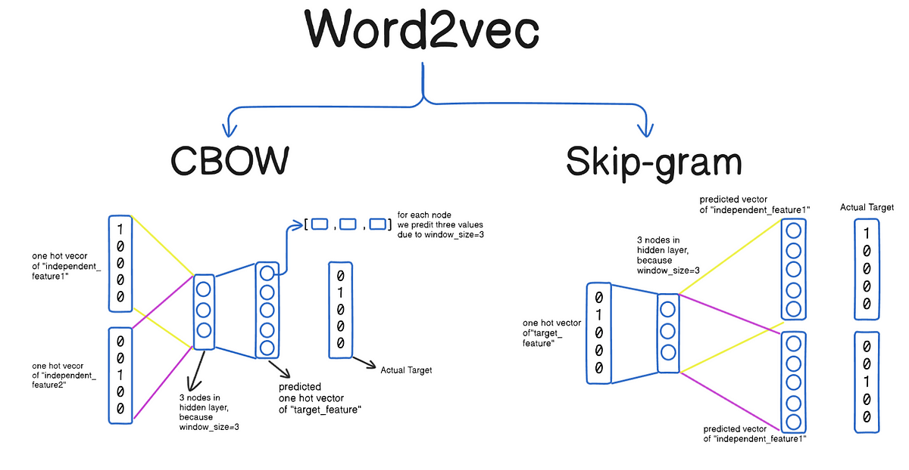
2. RELATIVE STUDY
Overvies Word2vec model
There are two primary architectures in Word2Vec : Skip-Gram and Continuous Bag of Words (CBOW)
Notes:
There are two primary architectures (A CHI TẸC CHƠ: KIẾN TRÚC) in Word2Vec [4]: Skip-Gram and Continuous Bag of Words (CBOW)
AND
The Skip-Gram model predicts context words given a target word, whereas the CBOW model predicts the target word from its surrounding context words.
The CBOW (Continuous Bag of Words) model differs from the Skip-Gram model in that it predicts the center word based on the surrounding context words.
CBOW tends to train faster than Skip-Gram, but it generally has lower accuracy

Slide 7
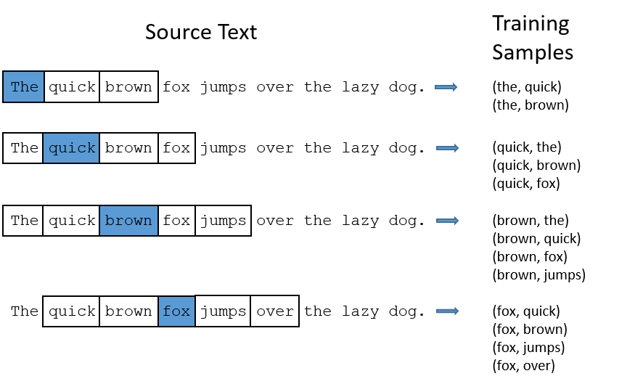
2. RELATIVE STUDY
Overvies Word2vec model
SKIP-GRAM:
Notes:
Skip-gram solves a simulated task (predicting context words from central words) to learn meaningful embedding vectors.

Slide 8
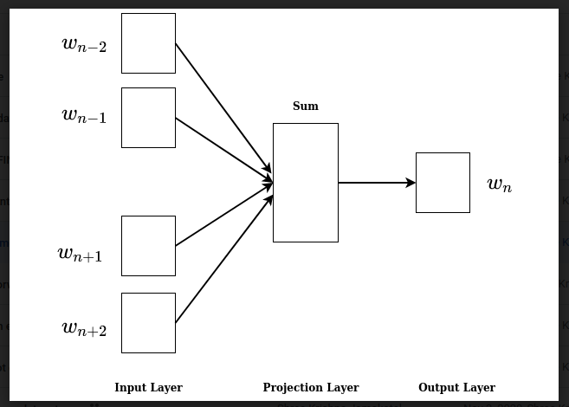
2. RELATIVE STUDY
Overvies Word2vec model
Continuous Bag of Words (CBOW):
Context of word : the model will predict a target word to define the context of the given word, similar to the Bigram model.
Context of phrare: the CBOW model averages the vectors of the words in the context group
Notes:
and this is how the rest of the Word2vec Model Overview covers

Slide 9
3. METHODOLOGY
Data Analyst
Data Processing
Training Model
Evaluate Model
Deploy
The overall process of implementing the model in the following steps:
Notes:
DATA ANALYST
DATA PROCCESSING
TRANNING MODEL
EVALUATE MODEL
AND DEPLOY

Slide 10
4. CONCLUSION
The highest recall value reached 0.6, indicating that the model was able to capture 60% of the relevant items during the evaluation process.
However, precision was recorded at 0.5, meaning that only half of the predicted items were relevant, with the other half being less relevant or irrelevant.
For future development, we plan to transition from the Word2Vec model to more advanced models, such as BERT model.
We plan to incorporate more advanced evaluation metrics, such as Normalized Discounted Cumulative Gain (NDCG).
Notes:
And now last context is conclusion
the word2vec model is achieved 0.6 which is 60% of relevant items in the evaluation process
However, Accuracy is only 0.5 so related prediction items are only 50%

Slide 11
THANK YOU VERY MUCH
Can Tho University

